Slide 1

Software Testing For SauceDemo Web Application
Prepared by :-
1- Abdullah Mohamed Megahed Abdelnabi
2- Kareem Mohamed shawki Mohamed
3- Abdelrahman Mohamed Hussein Ali
4-Shady Emad Kolta Henin
5-Yossif Mohamed Abbas Helmi

Slide 2
Online retail websites need reliable and secure user experiences. Bugs or broken login processes reduce customer trust and conversions.
Test the SauceDemo site to ensure functional integrity across user login, item purchase workflow, and UI responsiveness.
Demonstrates practical black-box and functional testing on a public demo site widely used in QA training.

Slide 3
As part of our software testing project for the SwagLabs site, we've developed a project wireframe that visually outlines the key interfaces we're testing—such as the login screen, product listings, shopping cart, and checkout flow.
This wireframe serves as a guide to understand how a typical user navigates through the site, from logging in to placing an order.
By mapping this user journey, we can identify critical touchpoints to test for both usability and functionality. This helps us plan and prioritize our test cases effectively and ensure that users experience a smooth and bug-free process.

Slide 4
Primary User Personas:
Individual shoppers (tech-savvy users buying products online)
Testers/QA engineers (using the site for automation and manual testing practice)
Key Features:
Secure login authentication
Product catalog and sorting
Shopping cart and checkout process
Inventory management (backend-facing)
Error handling and data validation
Problem-Solution Mapping:
Shoppers: Need a seamless shopping experience → Clear UI, responsive actions, no bugs during purchase
QA testers: Need testable scenarios → Well-structured workflows, predictable responses, test data available

Slide 5
Data Source & Format:
Excel files were used to preview test cases and results
Each row represents a test case (e.g., login test, checkout validation)
Columns include: test ID, feature tested, input data, expected result, actual result, pass/fail
Data Shape & Characteristics:
Structured, tabular format (relational in nature)
Balanced set of functional and edge-case scenarios
Includes both positive and negative test data
Data Flow:
Manual or automated input via test scripts
Data stored in CSV/logs, then parsed for analysis
Used to evaluate consistency, detect bugs, and validate feature functionality

Slide 6
Main Language:
Java : used for writing and executing all automated test scripts
Framework/Tool:
Selenium WebDriver : enables browser-based testing by simulating user actions
Supporting Technologies:
JUnit/TestNG (if used) : for structuring test cases and managing assertions
Browser Drivers : Chrome Driver and Microsoft internet explorer for executing tests in a real browser environment
IDE: IntelliJ for development and debugging

Slide 7
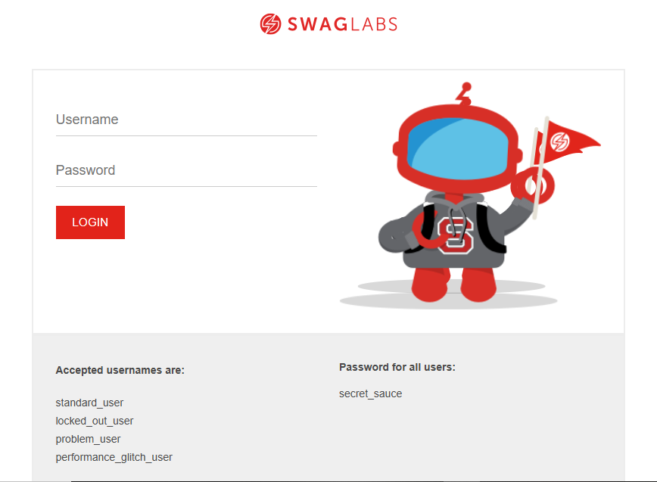

Live Application Status:
SwagLabs is a publicly accessible test website (stable/beta environment)
Used primarily for training and testing automation workflows
Testing Phases:
Unit Testing: Validated individual functions (e.g., login, button clicks)
Integration Testing: Tested complete user flows like “add to cart → checkout”
UI/User Testing: Focused on user experience issues and bug detection in live browser sessions
Feedback & QA Observations:
Identified bugs such as faulty cart item count, flaky login under certain inputs
Positive feedback on site responsiveness and test coverage
Improved reliability through repeated test cycles and scenario coverage

Slide 8
Reports & Documentation: Test Plan Document Test Case Report (with pass/fail results) Bug Report (documented issues and fixes) Summary Report (overall project findings and recommendations) Final Products: Java + Selenium Source Code (test scripts) excel sheets of test cases and results Slides for presentation GitHub repository link with all files (https://github.com/abdullah03megahed/DEPI-projects.git)

Slide 9
Team Members:
1- Abdullah Mohamed Megahed: Team Lead 2- Kareem Mohamed Shawki 3- Youssef Mohamed Abbas 4- Abdelrahman Mohamed Ali 5- Shady Emad Kolta Key Responsibilities: Script development, execution, and debugging Bug tracking and test reporting Creating deliverables and organizing final presentation Team coordination and progress tracking

Slide 10
Thank You
Any Questions …?

